Slide 1
Cisco Wired and Wireless Portfolio (Cat9k, WLC&AP)
David Bernášek
david.bernasek@techdata.com

Slide 2
Need for Higher Speeds in Campus Network Infrastructure ready?
802.11ax
4K Video
Virtual Reality
Augmented Reality
Rapid Growth of Powerful Endpoints
Advanced wireless connectivity technologies such as 802.11ax

Slide 3
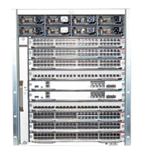
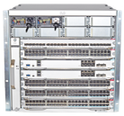
Cisco Catalyst 9000 Portfolio
C9300
C9400
C9500
NEW
NEW
C9300-24T
C9300-48T
C9500-32C
C9500-32C
C9500-32QC
NEW
C9500-32QC
NEW
C9300-24P
C9300-48P
July
2018
C9500-24Y4C
C9500-48Y4C
C9500-24Y4C
C9500-48Y4C
C9500 High Performance
C9300-24U
C9300-48U
SHIPPING
C9500-24Q
C9500-12Q
C9300-24UX
C9404R
C9407R
C9410R
SHIPPING
C9300-48UXM
SHIPPING
C9500-40X
C9500
C9500-16X
C9400-SUP-1
C9400-SUP-1XL
SHIPPING
SHIPPING
C9300-NM-4G
C9300-NM-4M
C9300-NM-2Q
C9300-NM-8X
C9300-NM-2Y
C9400-LC-48T
C9400-LC-48U
C9400-LC-48UX
C9400-LC-48P
C9500-NM-2Q
C9500-NM-8X
950WAC
950WDC
SHIPPING
SHIPPING
SHIPPING
July
2018
SHIPPING
SHIPPING
SHIPPING
SHIPPING
SHIPPING
SHIPPING
715WAC
C9400-LC-48S
C9400-LC-24S
C9400-LC-24XS
350WAC
1100WAC
715WDC
SHIPPING
July
2018
Platinum Rated PSU
C9400-PWR-3200AC
C9400-PWR-2100AC
C9400-PWR-3200DC
650WAC
930WDC
1600WAC
1600WDC
PSU for C9500-32QC/ 48Y4C/ 24Y4C
PSU for C9500-32C

Slide 4
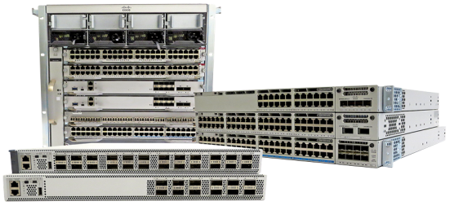
Introducing the Cisco Catalyst 9000 platform
First in enterprise
x86 CPU with application hosting
Programmable ASIC
Software patching
Open Cisco IOS® XE
Converged ASIC
Single image
Common licensing
UADP 2.0
Unmatched in industry
High availability
Multigigabit density
Cisco UPOE® scale
Future ready
IEEE 802.11ax ready
5G Ethernet ready
100G Ethernet ready
Security
IoT convergence
Mobility
Cloud

Slide 5
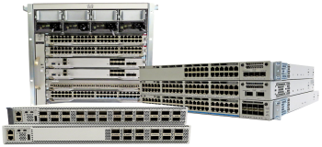
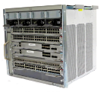
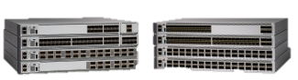
Cisco Catalyst 9000 platform transitions
Cisco Catalyst 9400 Series
Cisco Catalyst 9000 switch platform
Cisco® Catalyst® 9300 Series
Cisco Catalyst 9500 Series
Cisco Catalyst 3850 copper
Cisco Catalyst 4500E Series
Cisco Catalyst 3850F/4500-X
Cisco Catalyst 6840-X/ 6880-X
Access switching
Backbone switching

Slide 6
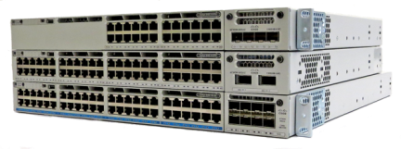
What is new with the Cisco Catalyst 9300 Series New generation of fixed access
Cisco Catalyst 9000 leadership
UADP 2.0
Cisco IOS® XE Software
SD-Access
x86 CPU and containers
Encrypted Traffic Analytics (ETA)
AES-256/MACsec-256
Trustworthy systems
Cisco StackWise® Virtual
IEEE1588 and AVB
NBAR2
Perpetual/Fast PoE
Model-driven programmability
Patching/GIR
Streaming telemetry
2.5G at the price of 1G
40G at the price of 10G
Highest 2.5G, 5G, Multigigabit density in the industry
Multigigabit + 2.5G
12 ports Multigigabit + 36 ports 2.5G
1G data
Only stackable switch with 8x 10G and 2x 25G uplinks
24 ports 1G
1G Cisco UPOE/PoE+
48 ports 1G
Multigigabit Cisco UPOE
48 ports Multigigabit
Modular fans
Modular uplinks
Higher-efficiency AC and DC power supplies
New Platinum rated
NEW
NEW
NEW
NEW
8x 10G
2x 40G
4x Multigigabit
4x 1G
2x 25G
315W AC
715W AC
1100W AC
Notes:
Catalyst 9300
Evolution of mGig with 5G wireless – C9300-48UN (48p 5G)
C9300-48UXM-E/A [12P mGig + 36P 2.5G]
mGig uplinks – C9300-NM-4M
25G uplinks – C9300-NM-2Y
Higher-efficiency (Platinum-rated) AC and DC power supplies – 315W AC, 715W AC, 1100W AC, 715W DC

Slide 7
Cisco Catalyst 9300 innovations and benefits
Flexible ASIC
UADP 2.0
Optional bluetooth
management
USB 2.0
Powerful CPU complex
Intel x86 CPU
4-core 1.8GHz
8 GB memory
16 GB flash
Wireless scale
48x Wave 2 access points in 1RU
Most dense and flexible uplink offering
8x 10G, Multigigabit, 25G
Unmatched PoE
Resiliency – perpetual/fast
High power – 60W Cisco UPOE®
Extends 3850 leadership
1.5x throughput
4x VRF scale
2x wireless scale
4x Wave 2 access points supported
2x to 4x flash, memory
Pluggable storage
2x CPU performance
2x uplink scale
25G and Multigigabit uplinks
Densest 5G access
8x 10G, 2x 40G UL at price of 2x 10G
Local storage
Removable storage (120GB)
Most flexible stacking
Front* and back stacking
Multiple cabling types – copper and fiber
Best HA – NSF/SSO
Redundant fans
Intelligent power
management
Cisco StackPower®
Optional power supplies
Power supplies (AC)
High-efficiency power supplies
Power supplies (AC)

Slide 8
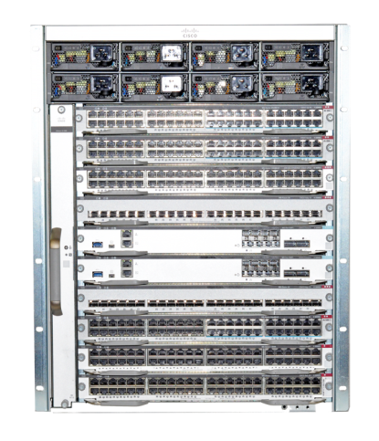
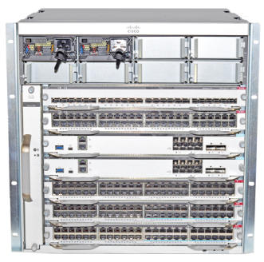
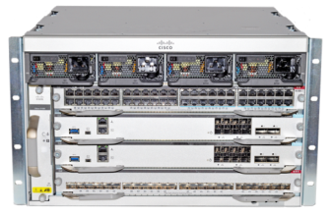
Introducing the Cisco Catalyst 9400 Series New generation of modular access
9 Tbps system bandwidth
Cisco® Catalyst® 9000 leadership
UADP 2.0
Open Cisco IOS® XE
SD-Access
x86 CPU and containers
Encrypted Traffic Analytics*
256-bit MACsec*
Trustworthy systems
Cisco StackWise® Virtual*
IEEE1588 and AVB*
NBAR2
Model-driven programmability
Patching and GIR
Streaming telemetry
Redundancy
is now
table stakes
Industry’s highest PoE
scale
4-Slot*
7-Slot
10-Slot
Supervisor
Sup-1: 80G per slot access optimized
Sup-1XL*: 120G per slot core optimized
Access line cards
24x Multigigabit + 24x Cisco UPOE®
48x Cisco UPOE
48x PoE+, 48x data
Core line cards
24x 10G SFP+
48x 1G SFP
24x 1G SFP
Power supply
3200W AC
2100W AC
* Roadmap

Slide 9
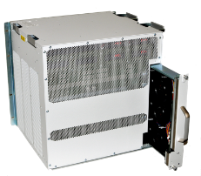
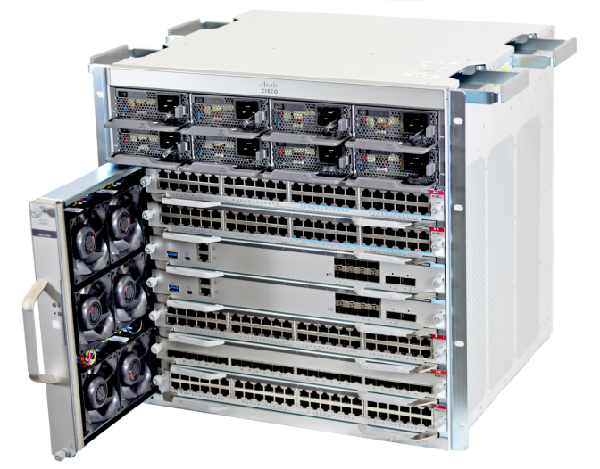
Cisco Catalyst 9400 Series: Innovations and benefits
N+1/N+N Modular power supply
Extending 4500E Series leadership in modular access
4x throughput
3x client scale
2x wireless scale
4x power scale
3x buffering
10x bandwidth
4x memory and flash
Lower power
Better acoustics
Higher MTBF
MPLS VPN
Ergonomic handles for efficient weight distribution
Mix AC and DC power supplies
Efficient Platinum-rated power supplies
Rear accessible fan tray for flexible cable management
Up to 480Gbps per slot
Cisco UPOE® simultaneously on all ports
Native 25G/10G and 40G uplinks
Dual serviceable fan tray
Up to 1TB SATA storage
Side-to-side airflow
Fits nonstandard racks (16 in.)
While preserving ….
HA architecture
Investment protection story
Intel x86 CPU, 4 core 2.4GHz
Rearchitected power distribution for 10% higher energy efficiency

Slide 10
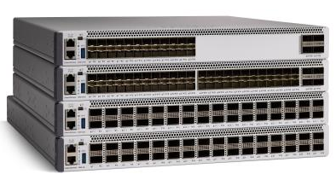
Cisco Catalyst 9500 Series New generation of purpose-built fixed core/aggregation
UADP 2.0
UADP 3.0
40G at the price of 10G
Industry’s first 40G enterprise switch
Optimized 10G switch for midsize backbone
1TB SSD storage
Industry’s first 100G enterprise switch
8x buffering vs. the competition
Extending Cisco® Catalyst® 4000 and 6000 Series leadership in fixed core
13x throughput (3.2 Tbps)
6x performance (1 Bpps)
No oversubscription
8x 40G density
Pluggable SSD storage
USB 3.0
4x memory and flash
2x CPU cores
Customizable templates
Cisco StackWise® Virtual
Cisco Catalyst 9500-16X
Cisco Catalyst 9500-24Y4C
Cisco Catalyst 9500-40X
Cisco Catalyst 9500-48Y4C
Cisco Catalyst 9500-24Q
Cisco Catalyst 9500-32QC
Cisco Catalyst 9500-12Q
Cisco Catalyst 9500-32C
Modular fans
Modular uplinks
Modular power supplies
Storage for application hosting
Notes:
Intel x86 CPU, 4 Core 2.4GHz

Slide 11
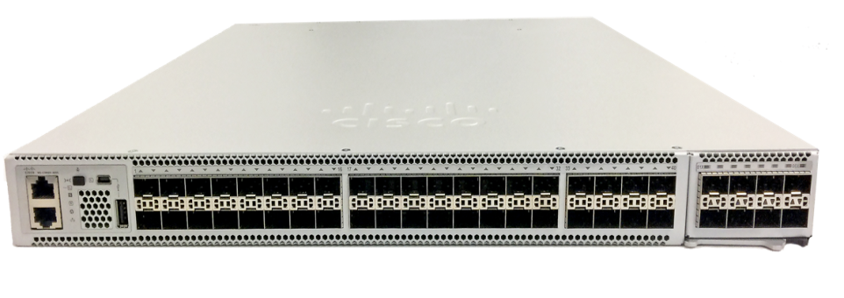
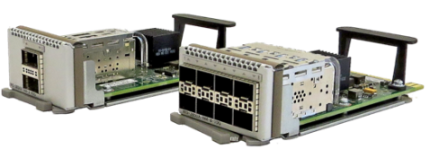
Cisco Catalyst 9500-16X For low-density 10G/1G deployments
March `18
Low-density 10G deployments
Transition 4500-X
24x 10G/1G ports
2x 40G, 8x 10G uplink options
Cisco StackWise® Virtual support on day 1

Slide 12
Catalyst 9K: Simplified Packaging
Current Three-tier Packaging
Simplified Two-tier Packaging
IP Services
Full L3 and Core Differentiators
DNA Advantage
Software Defined Access, Assurance and ETA Solution Package
IP Base
Routed Access and Access Differentiators
Network Advantage
Full L3 with flexible Segmentation and Network Resiliency
Lan Base
L2 Features and Competitive Parity
DNA Essentials
Simplified Network Operations Solution Package
Network Essentials Competitive Parity with Full L2 and Routed Access
Notes:
To summarize the Catalyst 3K switch licensing evolution, these are today offered in 3 tiers, starting with LAN Base for competitive situations, IP Base for routed access and other access differentiators, and lastly IP Services for full layer 3 and core differentiation. With the Catalyst 9K, we are reducing the tiers to 2: Advantage and Essentials.
Network Advantage includes full layer 3 with flexible segmentation and network resiliency, while DNA Advantage includes all licenses required to benefit from SDA, ETA and Assurance.
Network Essentials is our competitive platform that includes full layer 2 and routed access capabilities, while DNA Essentials provides a simplified network operations focus.
In the next few slides, we will delve into the detailed capabilities afforded through each package.
All DNA subscriptions are required at time of purchase, and are available in 3, 5 and 7 year terms.

Slide 13
Catalyst 9K Priced Right Delivering More Value
SD-Access Ready
7 Y
5 Y

Slide 14
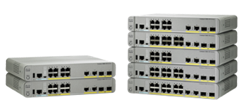
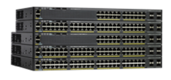
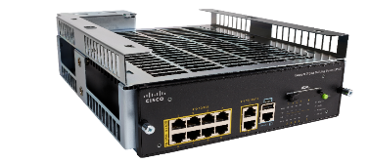
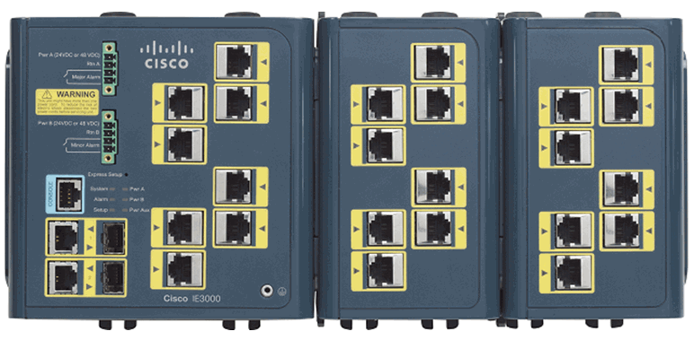
Extended Catalyst Volume Portfolio
SD-Access Extension
Full SD-Access
Catalyst 2960X/XR/L
Catalyst Compact
Industrial Networking
Catalyst 3650
Optimized for Data/Voice
Optimized for
Out-of-Wiring-Closet
Optimized for IoT
Optimized for Next Gen Workspace
Enterprise IoT
Lighting
BMS
Digital Building
8 port
UPOE/PoE+
L2
3650
IPBase/. IPServices
2960-X/XR
2960-CX
3560-CX
Industrial Ethernet
LAN Base/IP Lite
Stackable
LAN Base
IPBase/IPServices
UPOE
HA
Security
Programmability
L2
Advanced L3, L2
Warehouse
Smart Cities
Roadways
Parking Lots
IE5010
Routed Access, L2
IE4010
IE4000
Rack Mount
(GE & 10G)
2960-L
Fixed Din Rail
(GE)
LAN Lite+
Virtual Stacking
24/48 port
2960-L
8/16 port
IE2000
IE3000
Advanced Layer 3/Layer 2
Basic L3, L2
Fixed Din Rail
(FE)
Modular Din Rail
(FE)
Basic L3, L2
DNA-C Based Automation and Assurance (DNA E/A licenses now available!)
Lifetime Hardware Warranty, Software Upgrades included

Slide 15
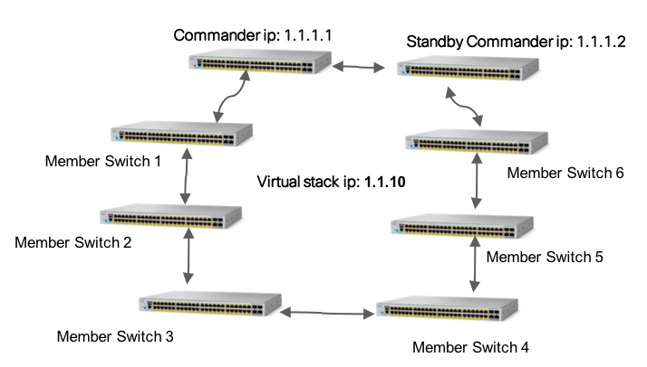
Flexible Stacking Options on the portfolio
FlexStack Extended
FlexStack Plus
Virtual Stacking
New
New
Long distance connectivity through optics
High bandwidth of 80 Gbps across stack of eight members
Single IP Management of up to 8 switches
Mix and Match ports based on deployment scenario with Fiber and Hybrid Module
Backward compatibility with FlexStack Plus Module for inside the wiring closet type of deployments
Single IP Management with options for high availability without any additional investment.
Catalyst 2960-X/XR
Catalyst 2960-L

Slide 16
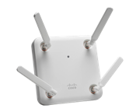
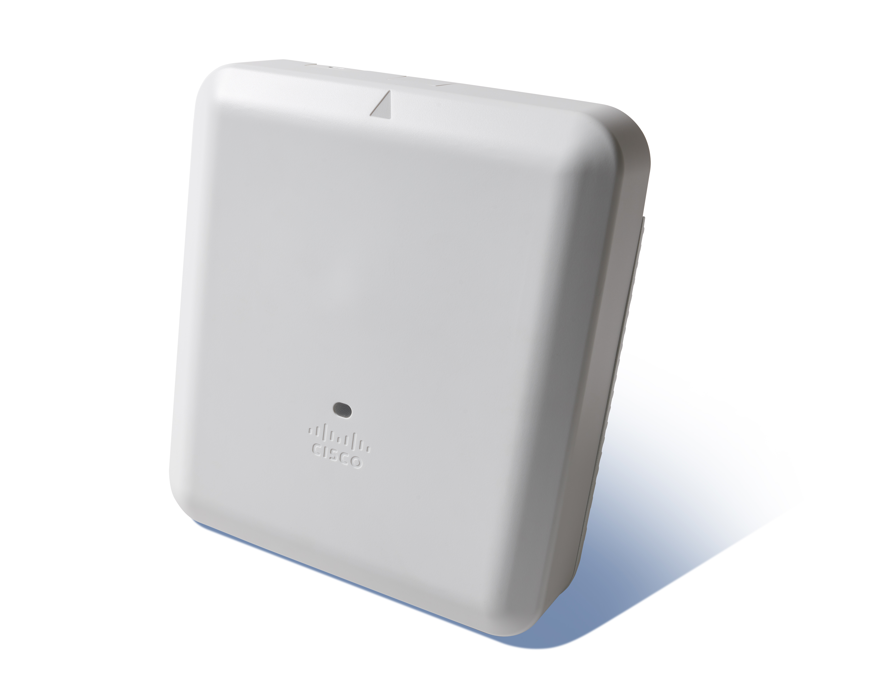
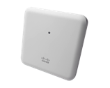
The industry’s most comprehensive and innovative access point portfolio The best infrastructure leads to the best outcomes
Good - Enterprise class
Better
Best in class
Ideal for small to medium-sized deployments
Mission critical
High density
3800 Series
4x4:3 SS 160 MHz
5 Gbps performance
2.4 and 5 GHz or dual 5 GHz
2 GE ports uplink or 1 GE + 1 Multigigabit (5G)
Cisco CleanAir and ClientLink
StadiumVision™
Internal or external antenna
Smart antenna connector
USB 2.0
Modularity for investment protection
NEW
4800
4 embedded radios (3 Wi-Fi and 1 BLE)
Cisco Intelligent Capture for DNA Assurance
Embedded Hyperlocation
4x4:3 SS 160 MHz
5 Gbps performance
2.4 and 5 GHz or dual 5 GHz
2 GE ports uplink or 1 GE + 1 Multigigabit (5G)
Cisco CleanAir and ClientLink
Internal antenna
USB 2.0
Integrated BLE
2800 Series
4x4:3 SS 160 MHz
5 Gbps performance
2.4 and 5 GHz or dual 5 GHz
2 GE ports uplink
Cisco CleanAir® and ClientLink
Internal or external antenna
Smart antenna connector
USB 2.0
1815 Series
Indoor/high-powered Indoor Wall plate/teleworker
2x2:2 SS 80 MHz
867 Mbps performance
Tx beamforming
Integrated BLE¹
Max transmit power (dBm) per local regulations²
3 GE local ports, including 1 PoE out³
Local ports 802.1X ready³
USB 2.0⁴
1830/1850 Series
3x3:2 SS 80 MHz/4x4:3 SS 80 MHz
867 Mbps or 1.7 Gbps performance
1 or 2 GE ports uplink
Internal or external antenna (1850)
Tx beamforming
USB 2.0
¹ Future availability
² Available for high-powered only
³ Available for wall plate and teleworker only
⁴ Available for teleworker only
Notes:
Cisco is unmatched in delivering the broadest, most innovative access point portfolio in the market, that now includes the 4800: the smartest AP on the market with Cisco Intelligent Capture & Hyperlocation technology
These APs exemplify Cisco’s commitment to delivering innovation on intent based networking platforms; from there actionable insights and assurance that are delivered with Intelligent Capture technology—ensuring data packet capture is done even before a network anomaly or a your boss’ telepresence on her iPad suddenly drops—so that full forensics up to the application layer can be done and the problem solved and avoided in the future. How cool is that? And when we add MLAI in the future, that TP never skips a beat.
It’s like get a full picture of a crime scene, but you have no missing puzzle pieces…you have the complete picture to pinpoint where the issue lies—in the network, in the application, in the driver or maybe some backend app.
We plan on making Intelligent Capture available across the portfolio, but it will have unmatched performance on the dedicated 3rd Wi-Fi radio on the 4800.

Slide 17
Wireless excellence and innovations delivered only by Cisco Aironet 2800, 3800 Series Access Points
Apple Fast Lane
Automatically assures highest priority, fastest performance for trusted apps on trusted Apple devices
Cisco CleanAir®
Remediates device Impacting Interference from other WiFi and non-WiFi devices
Zero Impact AVC
Hardware Based Application Visibility and Control without Impact to Performance.
Flex Dynamic Frequency Selection
Automatically Adjusts So Not to Interfere With Other Radio Systems
Multi-Gigabit Uplinks
Free Up Wireless With Faster Wired Network Offload
Optimized Roaming
Intelligently Connects the Proper
Access Point as People Move
RADIO 1
Gb+
2.4GHz. RADIO
RADIO 2
5GHz. RADIO
Turbo Performance
Scales to Support More Devices
Running High Bandwidth Apps.
Cisco ClientLink
Improves Performance of
Legacy and 802.11ac Devices.
Flexible Radio Assignment
Software defined radio automatically adjusts to dual 5GHz to better serve high client environment
Future Proof Expandability
Add Functionality Via Module, Smart Antenna Port or USB Port

Slide 18
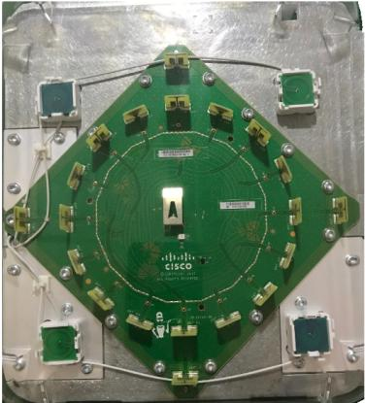
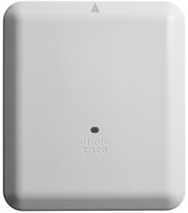
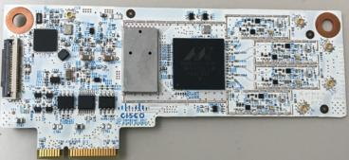
AP-4800 is a more advanced AP than the AP-3800 Similar to the AP-3800i but it has an additional Flexible Radio for Analytics + Advanced Hyperlocation antenna array
Location Array antenna is now integrated
Bluetooth Low Energy radio is now integrated
Embedded analytics/location radio is now integrated
+
=
Hyperlocation
antenna array
DNA Analytics, Monitoring
and Location Radio
AP-4800
Best in Class
Notes:
Similar in design to the AP-3800 the AP-4800 has these additional Hardware components.

Slide 19
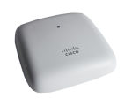
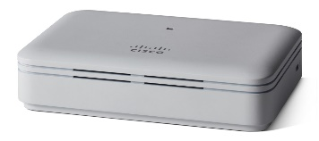
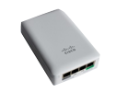
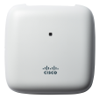
Which Access Point Is Right for You?
1815i is the infrastructure access point that suits organizations of all industries looking to provide enterprise-level networks at a fraction of the cost
1815t is targeted to teleworkers and microbranch deployments of all industries, so geography or weather will no longer get in the way of workplace productivity
1815w is a wall-plate-mounted access point that is ideal for hospitality, residential halls, and other multi-dwelling-unit deployments
1815m has more power to reach a larger area and is the perfect access point for budget-conscious organizations that need a wide coverage zone

Slide 20
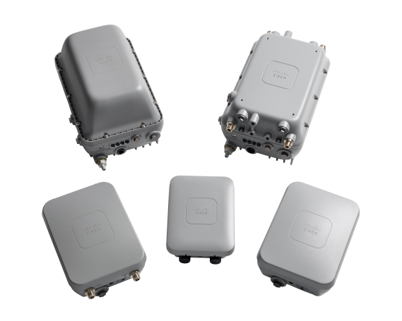
Cisco Aironet 1540 Series Outdoor Access Point Low-Cost, Simple-to-Deploy Outdoor Network
Why is it important to customers?
Addresses need for simple to deploy outdoor access point with low price and low power consumption
Supports high-performance 802.11ac Wave 2 Wi-Fi standard
Easy to deploy with Mobility Express support
Support for point-to-point* bridge with 1542D (internal directional antenna)
1570
1560
1560
1540
* PtP SW will be available in H2CY17
Next-Generation Wave 2 802.11ac Outdoor Access Point

Slide 21
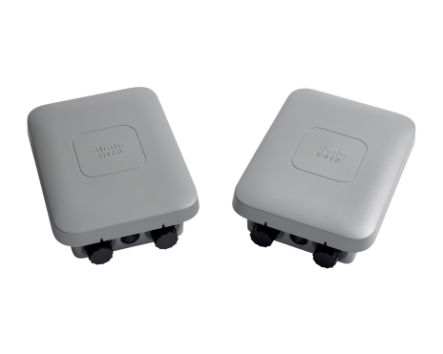
Next-Generation Wave 2 802.11ac Outdoor Access Point
Dual-radio 802.11ac Wave 2
2x2:2, 20/40/80 MHz channels
802.3af power (13W)
Small, lightweight (1.25 kg)
Ruggedized for outdoor use: IP65, temp -40° to +65°C (-40° to +149°F)
Cisco® Aironet® 1540 Series
Exceptional Performance at Exceptional Price

Slide 24
Wi-Fi standards on the move again
Should have 192-bit Security
Open network gets individualized data encryption
Simplified provisioning of IOT devices
Simultaneous Authentication of Equals against dictionary attack for customers with weak passwords
All 802.11ac Wave2 Enterprise and Meraki APs will receive the latest WPA3 functionality (end of 2018)
WPA3
Enhanced Network Efficiency – By multiplexing users using the wireless sub-carriers, OFDMA increases the efficiency of communication
Enhanced Link Efficiency – Primarily through the use of 1024 QAM
First 802.11ax AP (2019)
802.11ax
The future of wireless – faster and more secure connectivity!

Slide 25
Děkuji
David Bernášek
david.bernasek@techdata.com

